Slide 1

Introduction to ML-Classification
DSLA Course
Rohit Padebettu

Slide 2
Course Assignments
Programming Assignments
Reading Assignments
Presentation Assignments
Technical Skills Assignments
Writing Assignments

Slide 3
Technical Assignment
Install & Familiarize yourself with R and RStudio IDE

Slide 4
Programming Assignment
Install & Complete: Git / GitHub Tutorial
Install & Complete: Swirl – R Programming

Slide 5
Reading Assignment
Read Chapter 1: Introduction
Read Chapter 2: Statistical Learning
Read Chapter 3: Linear Regression
Read Chapter 4: Classification

Slide 6
Writing Assignment
What do you want your Resume to contain in 3 months ?
Create & Submit by Wednesday Aspirational Resume
Two pages maximum
List 3 projects or jobs
Explain the problem
Describe mathematical or statistical techniques used
Specific Metric you Improved

Slide 7
Presentation Assignment
By Tuesday Submit
2 Industries hiring data scientists where you would like to work
2 Types of data science problems they solve
Identify the Algorithms typically used to solve those problems
By Saturday Submit
3 examples of data science problems in your personal/professional life.
For each give
Relevant Question
Hypothesis
Data Source
Algorithm

Slide 8
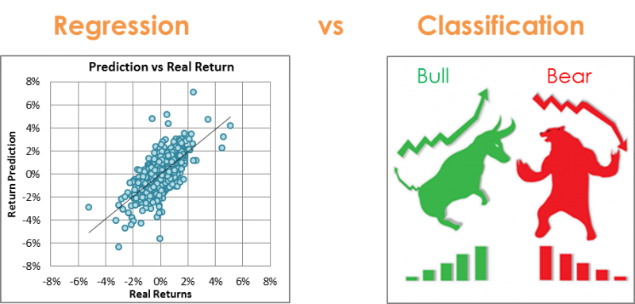
Regression vs Classification

Slide 9
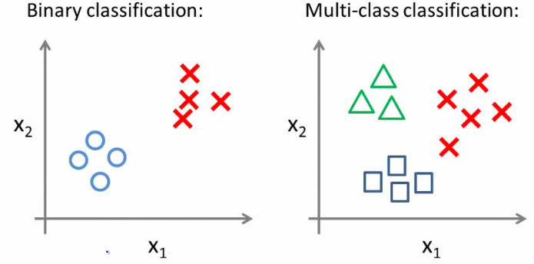
Classification - Types

Slide 10





Classification
examples
label₁
label₃
Labeled
Examples
Predicted Label
Data
Model
label₄
label₅
New Unlabeled Data

Slide 11
Classification – Real Life Examples
Hospital Emergency Room measures blood pressure, age, history of illness etc. of newly admitted patients. A decision needs to made regarding admitting the patients into ICU. They want to admit high risk patients. Problem is how to discriminate between high risk and low risk patients?
A Bank receives hundreds and thousands of loan applications with information about salary, age, marital status, other loans, credit history, employment status etc. The bank wants to make loans to those people who are most likely going to repay the loan. Problem is how to discriminate between those who are a good credit risk and those who are bad credit risk?

Slide 12
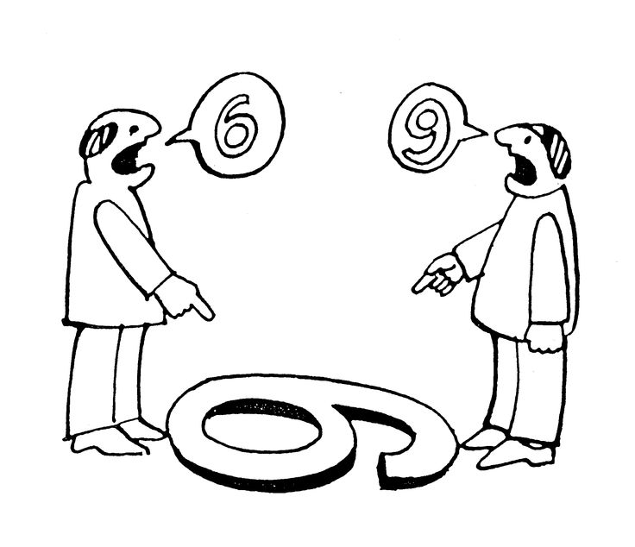
Classification – Other Examples
Face/Speech Recognition
Character Recognition
Spam Detection
Customer Segmentation
Recommendation Systems

Slide 13

Classification – How?
Use Machine Learning Algorithms – Duh!!
In this session we will learn about the following algorithms
Logistic Regression (Binomial)
Linear Discriminant Analysis (LDA)
Quadratic Discriminant Analysis (QDA)
K- Nearest Neighbors (KNN)

Slide 14
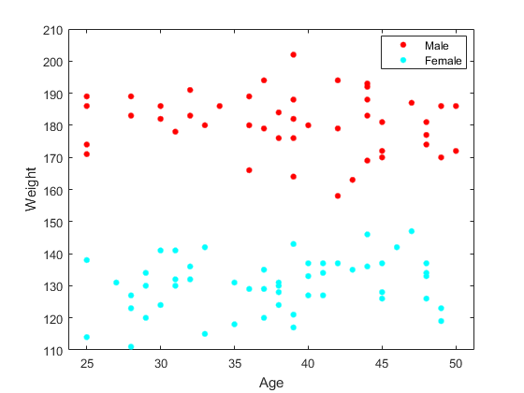
Logistic Regression- Binomial
Can you predict whether a person is Male or Female based on this Age and Weight Data?

Slide 15
Logistic Regression vs Linear Regression
Loan Default Probability

Slide 16

Logistic Regression- Binomial
We can estimate probability of Male or Female using a Linear Regression Model too, but don’t you think Logistic Model fits better?

Slide 17
Logistic Regression- Model
Turns out we can use similar method we used in Linear Regression but instead of RMSE, we use Maximum Likelihood to get a good fit!
Maximum Likelihood – Predictions as Close to the Truth as possible

Slide 18
Logistic Regression – Multiple Classes
How do we use Logistic Regression when we have more than two classes ?
It is possible but there are better ways

Slide 19
Linear Discriminant Analysis (LDA)
Can you predict whether a person is Male or Female based on this Age and Weight Data?
Linear Decision Boundary

Slide 20

Linear Discriminant Analysis (LDA)
How do we use LDA when we have more than two classes ?

Slide 21
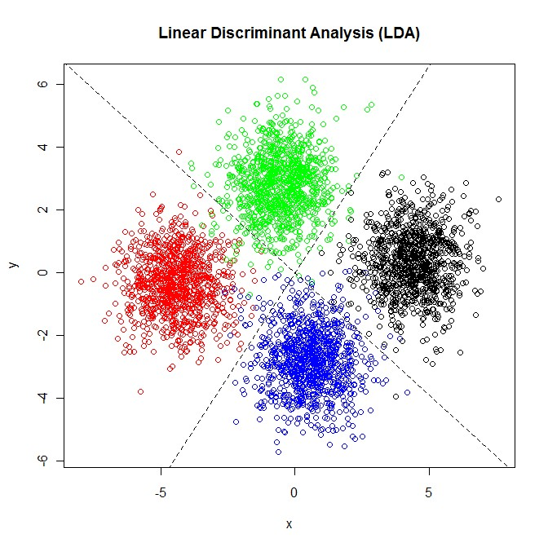
Linear Discriminant Analysis (LDA)
How do we use LDA when we have more than two classes ?

Slide 22
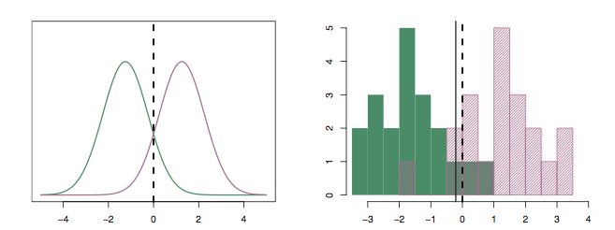
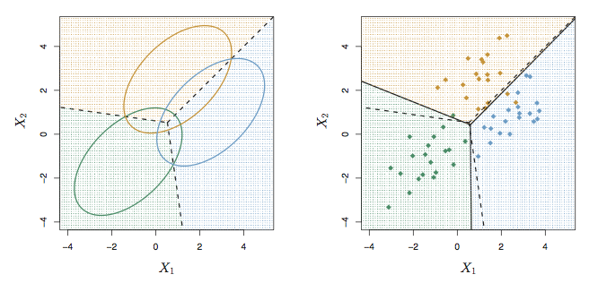
Linear Discriminant Analysis (LDA)
The main assumption we make here is that each of the classes are normally distributed but have different means.
Confusion Matrix

Slide 23
Quadratic Discriminant Analysis
What if the data is such that a straight line isn’t the best way to separate the data?
More flexible boundary
QDA is generally better when there is more data.
QDA can be prone to over-fitting for small data.

Slide 24
Quadratic Discriminant Analysis
What is the difference between LDA/QDA and Logistic Regression ?
Logistic Regression
LDA/QDA
Model parameters are computed by Maximizing Likelihood
Model parameters are computed using mean and variance from the data sample

Slide 25
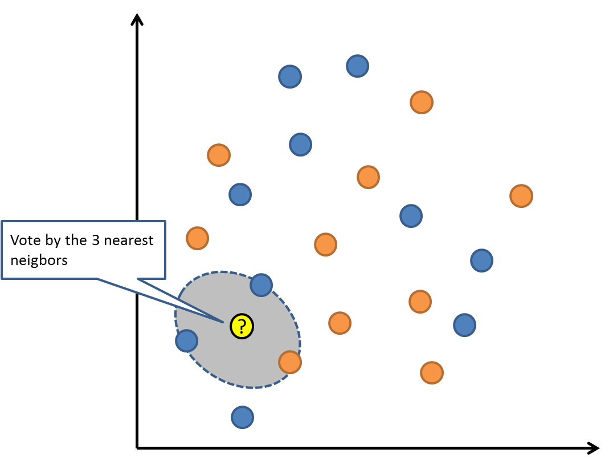
K – Nearest Neighbors (KNN)
Non-Parametric approach
Only input is value of K – how many neighbors?
Each point is assigned a class based on votes of the K nearest neighbors
Non-Linear classification boundary
K better be odd number. Why?
Various Distance Measures. Euclidean , Manhattan etc.
Is an age difference of 50 year same as salary difference of $50? Scale and Normalize Data.

Slide 26
K – Nearest Neighbors (KNN)
Very Flexible
Computationally expensive
Low K leads to over fitting (overly flexible)
High K leads to under fitting (linear)
Cross Validation (?) for K

Slide 27
KNN – Bias vs Variance
High Variance
Test error follows a ‘U’ shape
As K decreases (more flexible model) , training error decreases, but test error increases.
Over fit leads to High Variance
As K increases (more linear model), training error increases, but test error decreases and then increases again.
Under fit leads to High Bias
High Bias
1/K increase corresponds to K decreasing from 100 as you move left to right

Slide 28
Which Classifier is better?
Answer
It depends on the data !

Slide 29

Confusion Matrix
What is a Confusion Matrix?
X
A confusion matrix is a table that is often used to describe the performance of a classification model on a set of test data for which the true values are known.

Slide 30
Confusion Matrix
Why do we need this?
Is Classification Accuracy alone a good measure ?
What if there are unequal observations in two classes ?
What are the types of Errors the model is making ?
Remember this from LDA discussion?
97.2% Accuracy – not bad huh!!

Slide 31
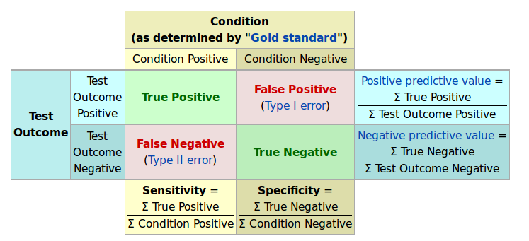
Confusion Matrix

Slide 32

Classification

